Slide 1
Access Physicians Guide to Managing COVID 19: A Living Document
Edward Goodman, MD
Director of Antibiotic Stewardship, Access Physicians
Core Faculty, Texas Health Dallas
January 25, 2021

Slide 2
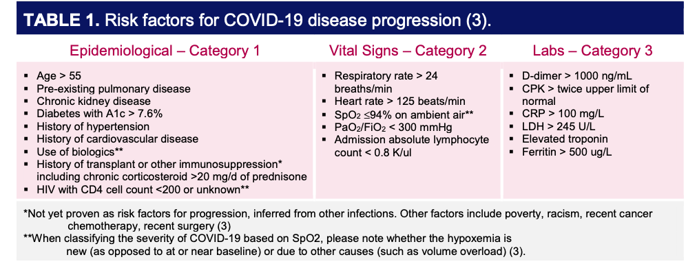
Prognostic Guidelines (AAMC 2020): not listed but include obesity

Slide 3
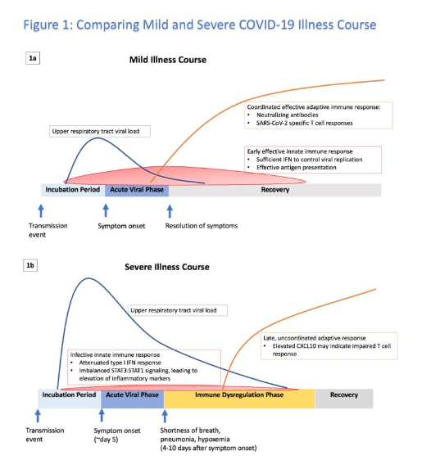

Slide 4
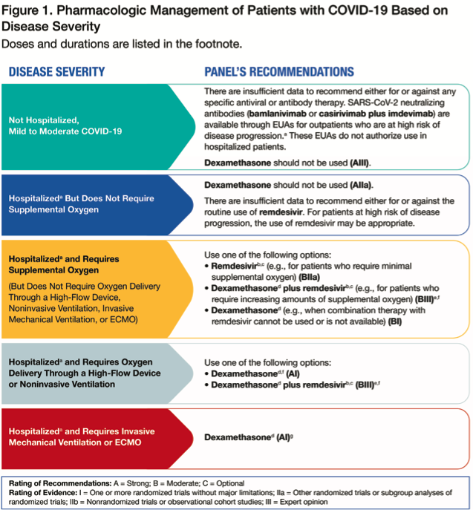
Risk Stratification and Rx
NIH 12/3/20

Slide 5
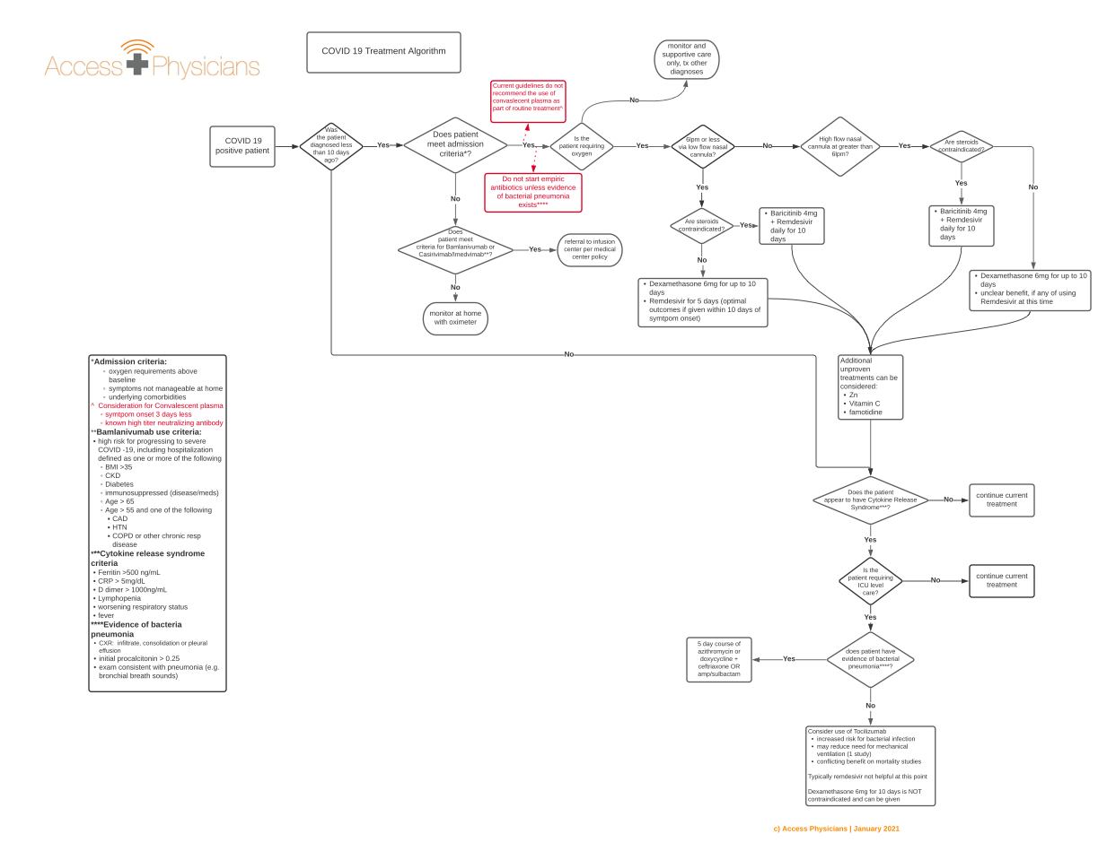

Slide 10
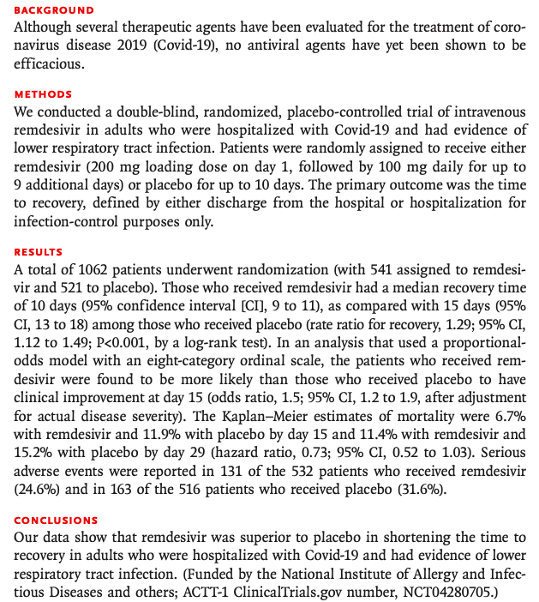
NIH ACCT I NEJM October 2020: 1000 patients

Slide 11
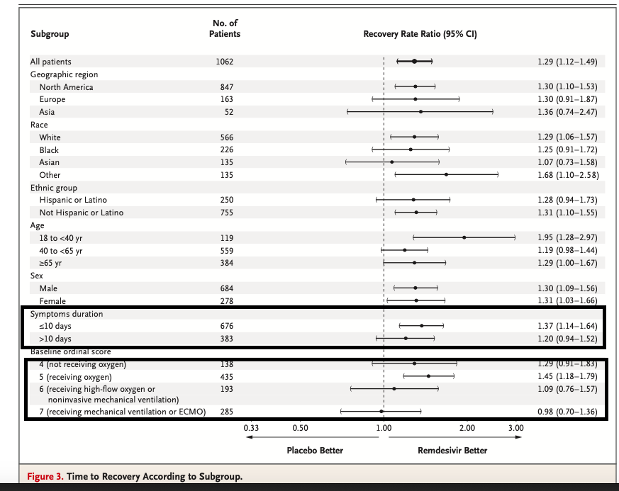

Slide 12
Conclusions
Start Remdesivir early for maximum benefit
  Within 10 days of onset
  When on low flow oxygen
  Five days duration
Give dexamethasone with it if at all possible in any patient requiring oxygen

Slide 13
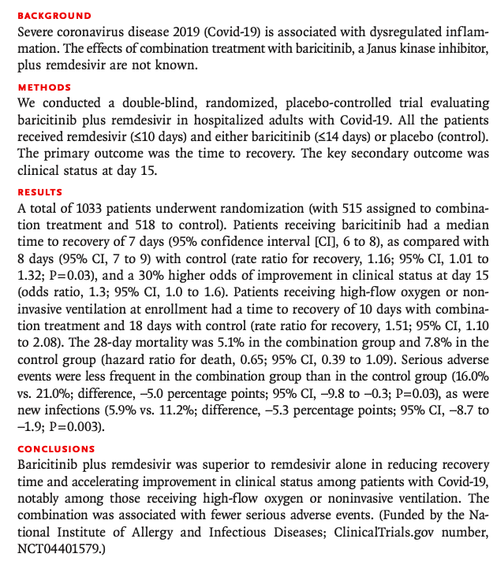
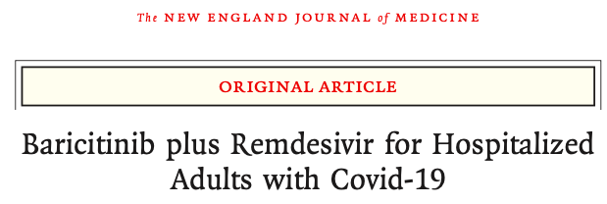
NEJM Dec 11, 2020

Slide 14
Warnings
Patients on steroids for treatment of COVID were excluded
Those who required steroids for "standard" reasons other than COVID after randomization had a higher incidence of serious or non-serious infection than those who did not require steroids
  56/223 (25.1%) versus 44/793 (5.5%)
Therefore, at this time, it should be reserved for those patients who should not be given steroids
  Poorly controlled diabetics
  Other co-existing infections where steroids are contraindicated
  Indicated for up to 14 days but Remdesivir is only indicated for 5-10 days
    Would stop baricitinib when completed remdesivir

Slide 15
What Are Not Routinely Recommended
Convalescent Plasma (NEJM 11/24/2020): insufficient data to recommend for or against (NIH/IDSA).
  Only seems effective if given early <=3 days of onset, and
  High neutralizing titer against spike protein (not available in most blood banks)
Tocilizumab (NEJM 12/10/2020, REMAP-CAP 1/6/2021): conflicting data
Hydroxychloroquine +/- azithromycin (debunked everywhere except right wing fringe)
Ivermectin (much hype, little data): NIH "no recommendation for or against"
Universal empiric antibiotics except in specific circumstances (my personal favorite!)

Slide 16
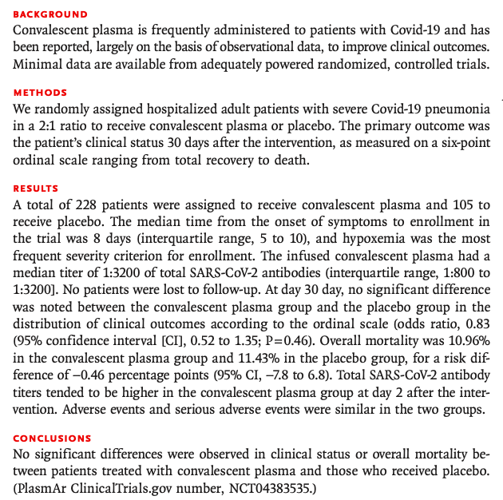
Example of Futility: Convalescent Plasma: NEJM Nov 24, 2020

Slide 17
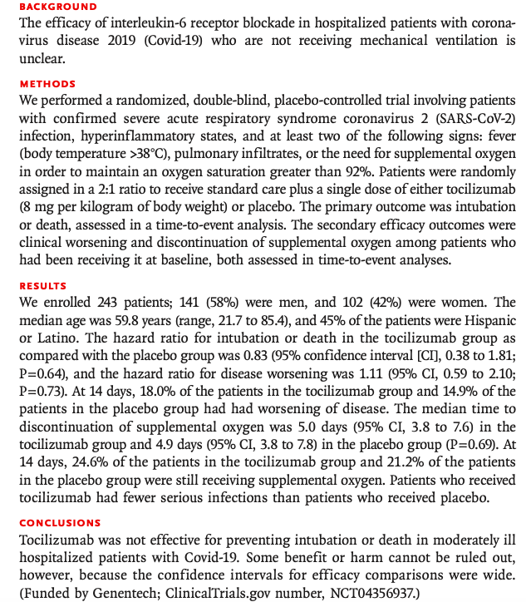
Example of Futility: Tocilizumab: NEJM Oct 2020 epub/in print 12/10/2020

Slide 18
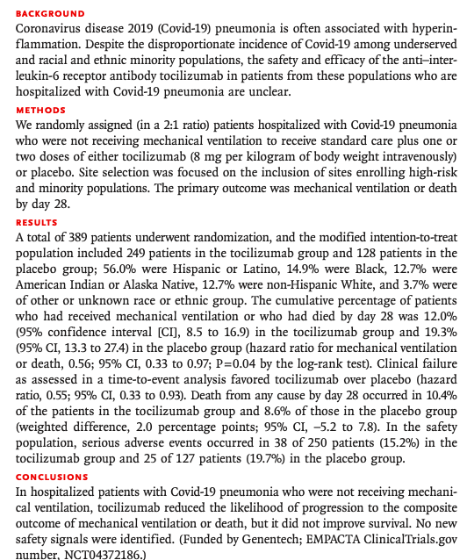
Controversy:
NEJM on line Dec 17, 2020

Slide 19
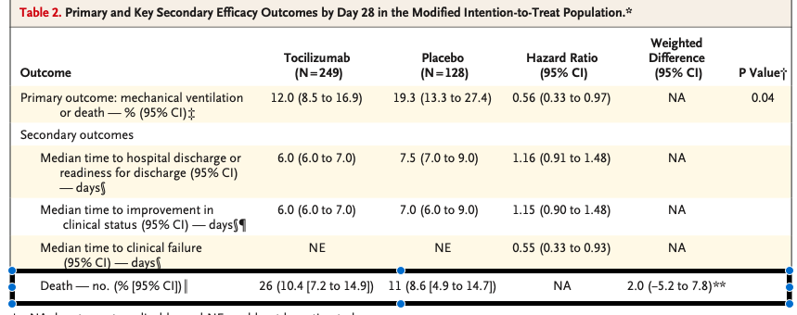
But, Hard to Understand

Slide 20
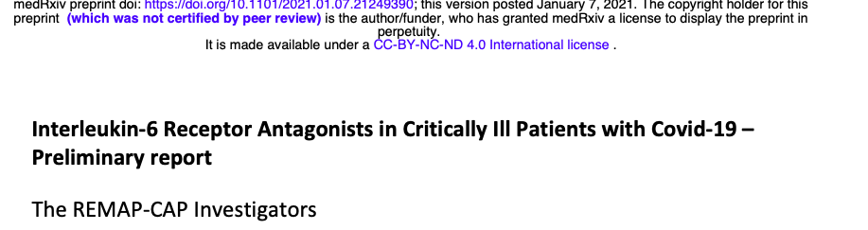
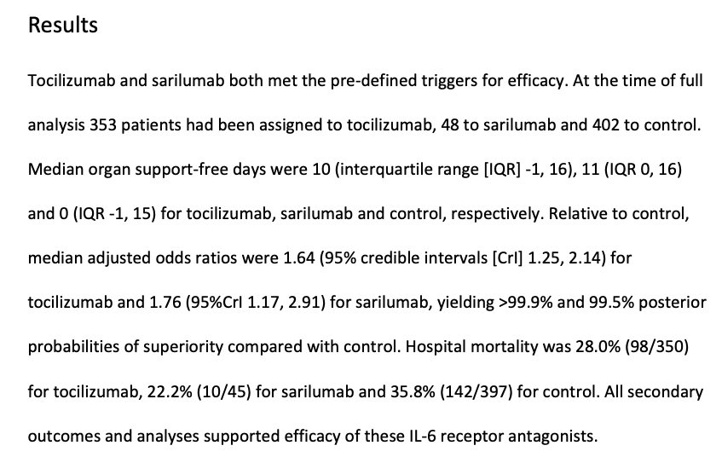

Slide 21
Interim Conclusions (pending peer-review publication)
No routine use of Tocilizumab
Consider for patients requiring ICU for organ support
  Cytokine release syndrome
  Within 24 hours of admission to ICU
  Give with high dose steroids
  Probably no benefit remdesivir
Expect pushback from Pharmacy/Administration

Slide 22
Stewardship: Empiric Antibiotics for Co-existing CAP
Quite uncommon: 1.6-3.7%
Not recommended unless
  Focal consolidation
  And PCT >0.25
If indicated
  Ceftriaxone and doxycycline PO for 5 days only
  Only use azithromycin if doxycycline is contraindicated
    Pregnancy
    Can't sit up to take pill
Once ventilated, prepare for VAP
  Bacterial or fungal

Slide 23
Disclaimer
These are only guidelines and can change at any time with the avalanche of new articles
The Access Physicians ID Service Line and Stewardship Leadership will endeavor to update this regularly

